Slide 1
Digging In
Getting Familiar With The Code To Be A Better Tester
Hilary Weaver-Robb | @g33klady | github.com/g33klady

Slide 2


New slides, who dis?
Hilary Weaver-Robb
SQA Architect
Notes:
Mention QL, stop at the booth, we’re hiring blah blah blah

Slide 3

https://tinyurl.com/testbash-detroit
Super Early Bird prices end on January 24th!

Slide 4

Story time!
Notes:
So A long time ago, at a software company far away, I worked with a bunch of software engineers that wouldn’t talk to me. I found myself missing things entirely because I wasn’t focusing in the right places – I was testing what was in the requirements document I got from the BA like 6 months back, but they had been meeting without me and changing what the application was going to do.
I felt out of touch with the whole process, like I’m just somebody they keep around to yell at at the end of the release cycle.
I left that place after not too long. With new teams and new technologies to work on, and the newfangled Agile methodology, I felt more in-tune with what’s going on.
I worked much more closely with the software engineers, and learned the tools they use to communicate what their code is doing with each other, and with the organization as a whole.
I started getting emails from source control with notifications of changes. It felt strange to have information sent to me, without me having to ask for it! And I started digging for more information

Slide 5
Digging in to Digging In
Commits and PRs
Static Analysis & Code Coverage
Dev Tools
Other Tools
Notes:
I want to show you some of those areas where testers don’t often venture, but we really should. We’re going to talk about a couple of specific areas where you can dig in to what’s going on in the code of the applications you’re testing, and how these can help you find some bugs.

Slide 6
This is not about learning how to code.
This is learning about the code
Notes:
I want to make clear that for this talk, you don’t need to learn how to code to get a lot of information from the code. I know that not everyone wants to learn to code like a software engineer, and that’s ok. But I feel very strongly that we should learn about the code we’re testing as much as we can.
It is, after all, the thing that makes up what we work with every day!

Slide 7
Commits and PRs
Notes:
First we’ll look at commits and PRs.
But to get into those, we need to get into

Slide 8
Version control (or source control) is a system that records changes to a file or set of files over time so that you can recall specific versions later.
https://git-scm.com/book/en/v2/Getting-Started-About-Version-Control
Notes:
Version control - it’s basically what saves our butts in software development all the time. Someone writes buggy code and pushes it out, we can go back to the previous version until they fix it and learned their lessons.
Or if someone is working on a feature, then they go on vacation or win the sweepstakes or something and leave, or your laptop suddenly shits the bed – as long as they saved their code in version control, we don’t have much to worry about.
It saves me with my test automation code often

Slide 9






Version control
Notes:
There are many version control systems out there, these are just a few off the top of my head
I’ll be using terminology from Git for this talk. Terminology may be different, but the concepts between these are similar and you should still be able to use what we cover in your day to day work.
That is unless you have no version control at work, or your version control is just a bunch of folders on the devlopers desktop.

Slide 10

Version control
Notes:
Who here has access to the code of the applications you test?
Why should you care about version control if you’re not in the application’s code every day if at all?
Because that’s where the code you’re testing lives! It has many secrets hidden in plain sight!
For instance…

Slide 11
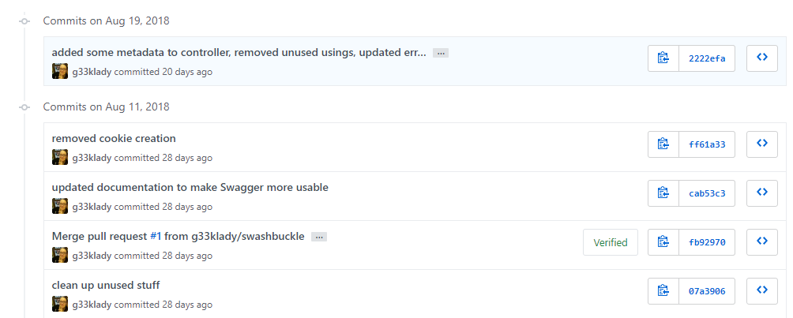
Commits
Notes:
Commits are smaller groups of changes, usually from a day’s work or less. Hopefully commits are happening more often than that – multiple times a day like all of these we see under August 11. And those commits hopefully have good, descriptive commit messages. But we can see what’s in the changes themselves, so even if those messages aren’t that great, we can understand what changed.

Slide 12


Pull Requests or PRs
master
fork
commits
PR
Notes:
PRs or pull requests are groups of commits. It’s called a pull request because you’re saying “I request that you pull in my changes”
Here’s how that works in general
Main version of the codebase, generally what’s in test/beta/production etc
Your fork
Commits
Commits
More commit
Pull request
Other pull requests that are now commits into master
Once ready, deploy out
To test environment
** we don’t want to have to dig through every single commit on everyone’s fork, but in the PR we can see the commits that went into it, and all of the changes that were made

Slide 13
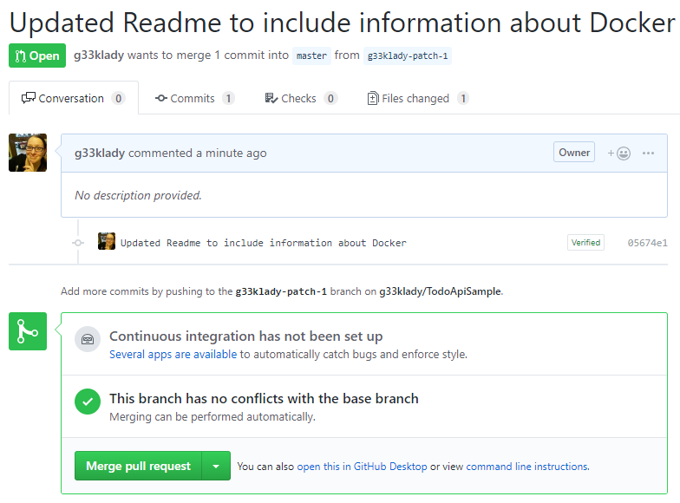
Notes:
In Git, this is what a PR might look like. This, and the rest of the commits/PRs and code we look at, are from my Todo List Appplication. Those that attended the workshop on Wednesday are very familiar with this application!
This is a simple change to a markdown file
This is the only commit
It’s also still open – it hasn’t been merged quite yet, so these changes in this file will not be deployed to our servers if we did a deployment right now.
* I can see the file being changed on the Files tab
The red lines are those being changed or removed. This line is totally going away
But we can see this one is just shifting up a line, from line 19 to line 18
And all this green is brand new stuff

Slide 14
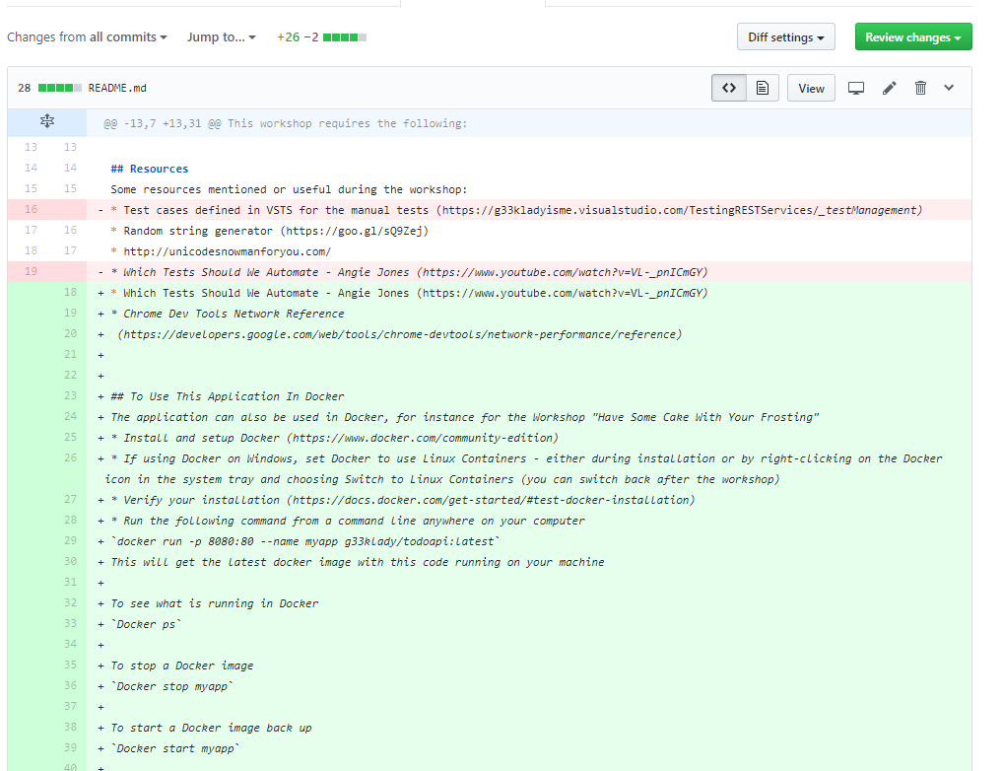
Notes:
In Git, this is what a PR might look like. This, and the rest of the commits/PRs and code we look at, are from my Todo List Appplication. Those that attended the workshop on Wednesday are very familiar with this application!
This is a simple change to a markdown file
This is the only commit
It’s also still open – it hasn’t been merged quite yet, so these changes in this file will not be deployed to our servers if we did a deployment right now.
* I can see the file being changed on the Files tab
The red lines are those being changed or removed. This line is totally going away
But we can see this one is just shifting up a line, from line 19 to line 18
And all this green is brand new stuff

Slide 15
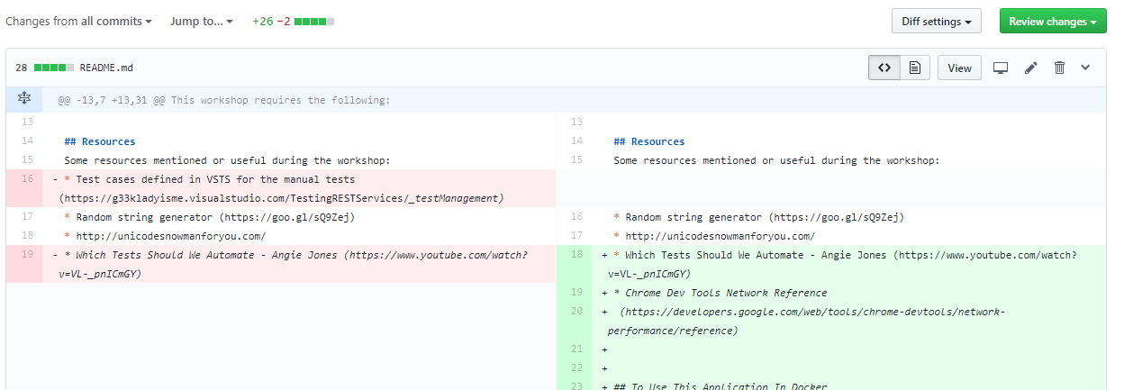
Notes:
You can see the changes a bit better with the split view, like this.
So this is just a markdown file, what does that really matter? Well this is the repository’s readme file, which tells other people how to use this stuff. It’s our documentation, really.
But lets look at an example with code

Slide 16
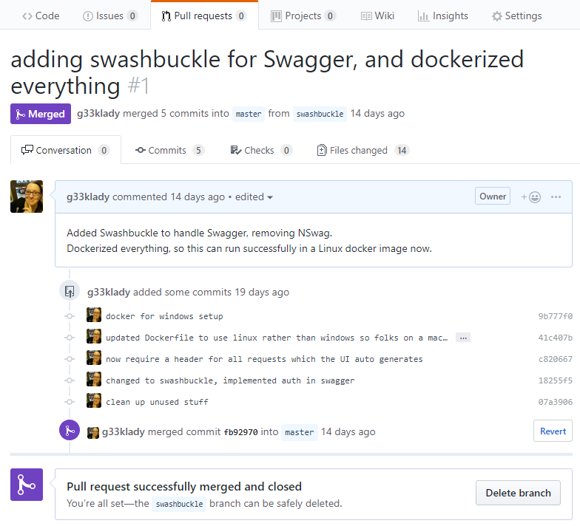
Notes:
This is from an application that has an API and webpage
* here’s the description of the PR – it says we’ve added Swashbuckle to handle Swagger, and Dockerized everything so it can run on Linux. Great!
These are the commits that make up the PR. From reading these we see that
something changed for our swagger documentation,
we’re now requiring a header for all requests (which the UI will auto generate),
and we have docker support added
So one thing conveniently forgotten from the PR description is that
* we’ve added a header that we’re now requiring, and the UI will auto-generate that.

Slide 17
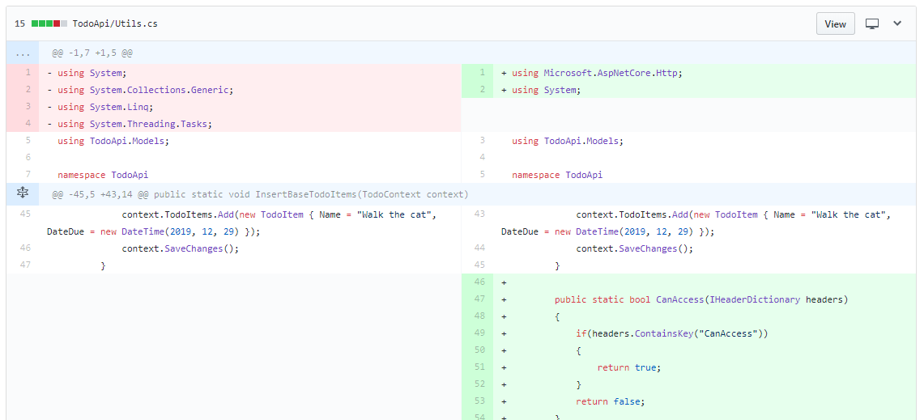
Notes:
This is our Utilities class
I see we’re removing some unused using statements things here
I can see from this we’re adding a method that checks the header of requests to the API and sees if the key CanAccess is there
And changes to this file

Slide 18
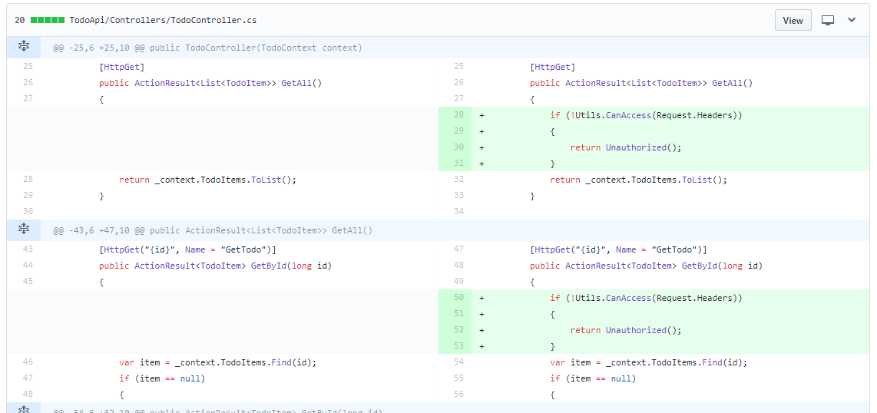
Notes:
Which is a controller. This tells the API what to do.
And here’s that header again. It’s checking if someone calls the API, if they don’t have that header, then we return Unauthorized and basically don’t let them get the information they want from the API
So knowing that this application has a webpage, I can look to see how we’re letting the webpage access the API. Remember that commit said “the UI auto generates the header” so we can look to be sure it does

Slide 19
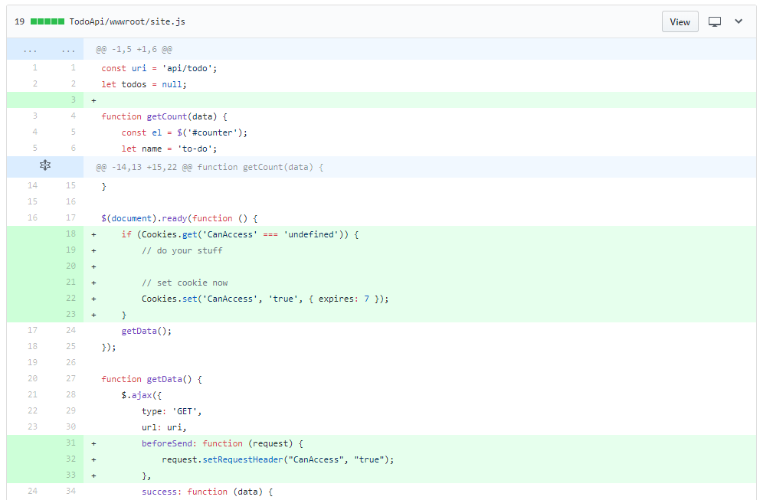
Notes:
Ok so this is our main javascript page for the site
Here I can see… wait a second, we’re setting Cookies here
And here we’re adding a header to the request like we’d expect
But what’s going on with this Cookie? Do we really need this here? What’s it actually doing?
* This looks like old code that shouldn’t be here. Look at those comments – this might have been copied/pasted in from somewhere and then slightly modified
So that right there is a conversation

Slide 20
Notes:
By clicking on the plus sign on the line you want to comment on.

Slide 21
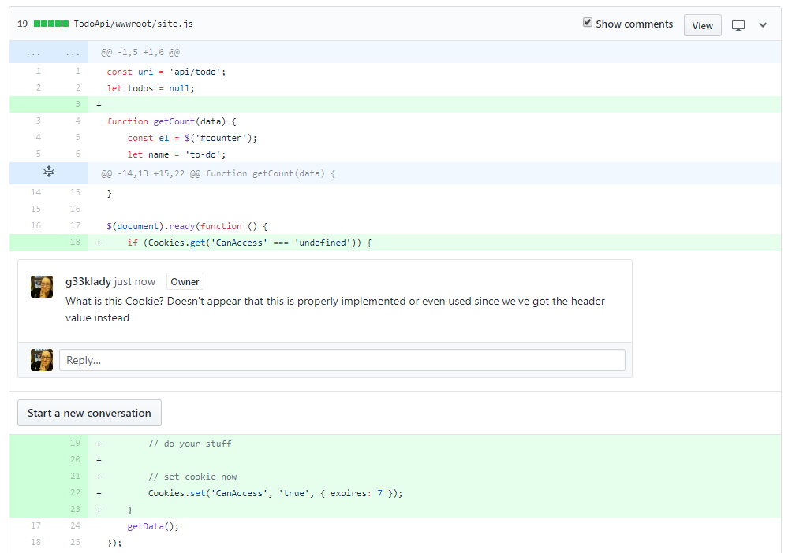
Notes:
*You can add a comment in the context of the code that is the issue
So even before this code gets deployed out to the servers for me to test, I can talk to the developer and ask what this cookie thing was about. Should it be here?

Slide 22
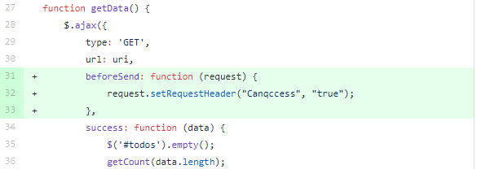
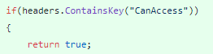
Notes:
What else can I do with this information? Why do I care about PRs?
What if one of these “setRequestHeader” functions had “can access” spelled a bit differently? There’s a “q” where an “a” should be. Is this going to cause a problem?
Yep!
Remember we’re checking for this exact string, written exactly like this (though headers are case insensitive)
Someone else might not notice this. We have the super powers of attention to detail, so we’re built to see this!
But say you didn’t review it, or didn’t catch this during the review of the PR, and this gets merged and deployed out to Test
* Notice that this is in our GetData function, which is how our list of todo items populates the main page of the application

Slide 23

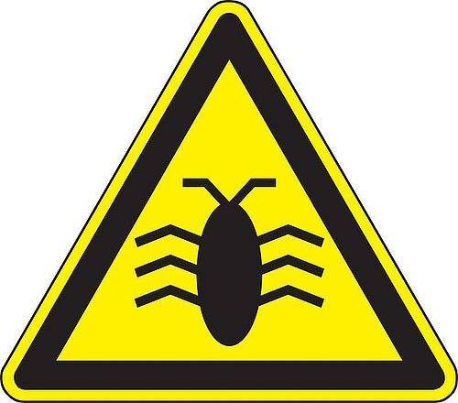

PRs
master
https://www.flickr.com/photos/fastjack/282707058/
Notes:
Ok so we’ve got all of these PRs, with a lot of commits, being merged into master and now we’re pushing out to the test server for us to test
So we start testing
And right away we have a problem. We can’t load the todoitems on the main page! Let’s try to troubleshoot this
So we try the request with Postman, using the new headers we know about because we always communicate really well with our developers! That request works fine
So we go back to the website, maybe using dev tools (which we’ll talk about later) to see what the issue is. Ah ok we see we have a 401 Unauthorized error. We dig into the requests and see that we are passing that header, but it looks wrong… Ah, we see it now. Just a misspelling! We can look through the commits to see who made the change, so we can assign it back to them
Now we can turn it over to the software engineer, who has already started work on the next thing. So she’ll need to stop working on that, create a new branch off of master

Slide 24
PRs
master
Notes:
So she makes her branch, and makes the change.
Then does a commit and a
PR, and then after that gets reviewed and accepted
It gets merged back into master.
Then we can deploy back out to the test servers and we can start testing again. So we’ve potentially lost a few hours, or a day or two if you’re really unlucky with the timing of everything
If we would have caught that before the PR was merged, the software engineer could have made the change very quickly, and committed the change which would add it to the same PR. So that’s potentially minutes rather than hours. Obviously this is a very simplistic scenario, but things like it happen all the time

Slide 25
Why care about commits and PRs?
Learn about & understand code changes firsthand
Get familiar with the codebase
Save time
Not about trust!
Notes:
So why even care about any of this? Shouldn’t the devs be catching these things
You can see what code changes are being made firsthand – you don’t have to wait for someone to tell you what they did, you can see it for yourself and you can understand all areas affected by a change.
These get you more and more familiar with the code that you are testing on a day-to-day basis. The more familiar you are with the code, the more information you have when testing
It can save you, and your team, time by catching issues while the dev is still in the mode of working on that feature or fix
And make sure you and the devs both understand this is not an issue with trust. This is giving you more information, so you and they can have more informed conversations

Slide 26
How to see commits and PRs?
Get any required permissions
Learn the VCS
Ask to be included in PR & code reviews
Tread carefully (if needed)
Notes:
How do you see these, then?
Get any and all required permissions to view the codebase, and
Learn about the Version Control System you’re using, look for videos on Youtube of how to get around it
Start to get involved in the PR reviews and code reviews in general, if you’re not already. Learn about what the developers are actually doing with those requirements! Are they looking at the acceptance criteria when reviewing each other’s code?
And tread carefully if you feel you need to. Some developers will be skeptical that you want to see their code, or sit in on the code reviews. You just want to understand the code better, so you can test better. It’s a win-win for everyone! Just be tactful when you find bugs!

Slide 27
Static Analysis & Code Coverage

Slide 28
Static Analysis is examining the code without executing it; providing understanding of code structure and ensuring the code adheres to industry standards
Notes:
Technically as testers, we do “dynamic analysis” of the code.

Slide 29
Static Analysis
“It does not prove that your program is correct. It just provides another set of eyes to help spot problems.”
- JSLint help file
Notes:
From the JSLint help file, I found this great description of what static analysis tools do – they don’t prove it’s correct, but can help spot some potential problems
There was mention earlier some linters for our test automation code, but we’re going to be talking about static analysis for the application code.

Slide 30
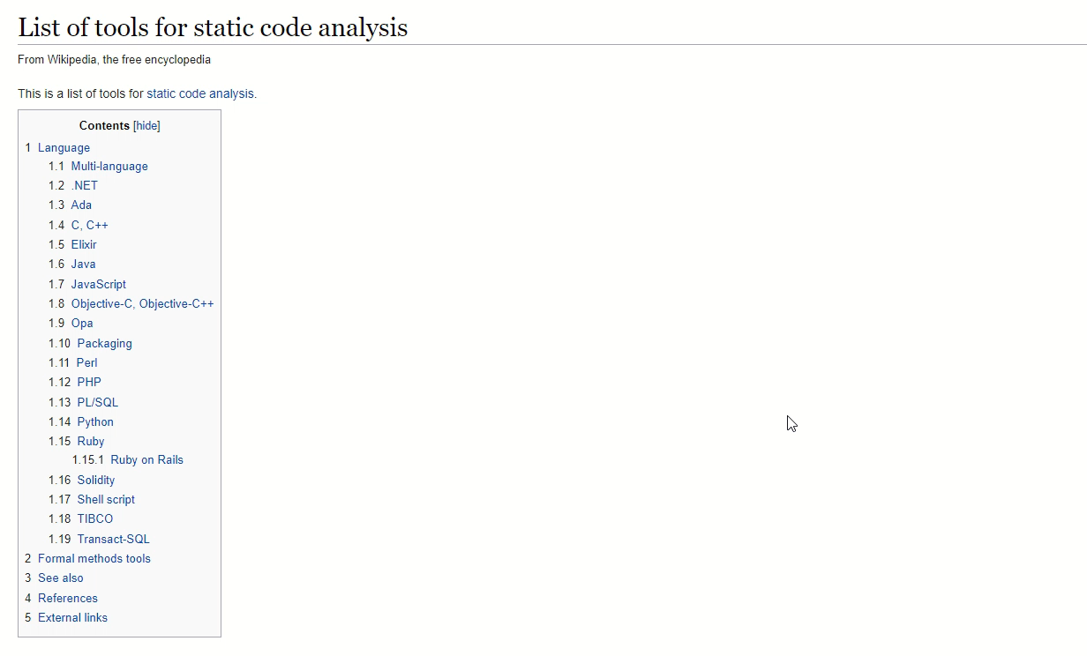
Notes:
There are a ton of tools out there to do static analysis, and obviously not a lot of time for us to go through even one in each language.
Mature, or progressive I guess, organizations will have a tool or tools set up. These give lots of shiny metrics that management loves to use.
And yes, they can be abused – something to keep in mind. Like any metrics these can be manipulated if someone feels the need. They’re also not 100% accurate – these tools use “generally accepted rules” to assess the code

Slide 31
Types of Issues
Cosmetic
Code Smells
Bugs
Vulnerabilities
Notes:
There are cosmetic checks we don’t really care about (this is the tabs vs spaces, or using semicolons in javascript or not – basically just the preferences the devs have)
Code smells – the code technically works but it’s kinda wonky, and could be better; they relate to how maintainable the code is, if it needs to be changed. When changes are made, if there are a lot of code smells, that could mean more incidence of bugs
Bugs are determined by the static analysis tool as issues with the code that, if not seen as broken now, it probably will show up as broken at the worst possible moment. So fix it soon
And Vulnerabilities, which are security concerns.
So the information we can get from a static analysis tool could help us find those “bugs” and “code smells” we may not have seen otherwise. I have used our internal static analysis tool to pinpoint my testing in areas that looked more sketchy.
I have seen teams set up their static analysis then kind of ignore it. This is a playground for us!

Slide 32
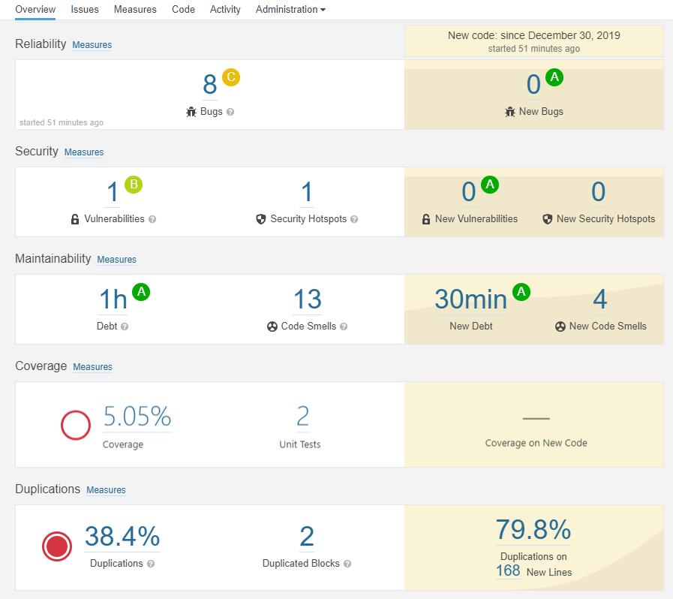
SonarQube
Notes:
This is a screenshot from one tool, called SonarQube. It supports a ton of different languages, so is useful for organizations with a variety.
We can see the Bugs identified, code smells, and code coverage which we’ll talk about in a minute
If we click on the bugs, it’ll take us to a detailed list of what’s wrong.

Slide 33
Notes:
Duplications, and code coverage which we’ll talk about in a minute
If we click on the Issues link at the top, it’ll take us to a detailed list of what’s wrong.

Slide 34
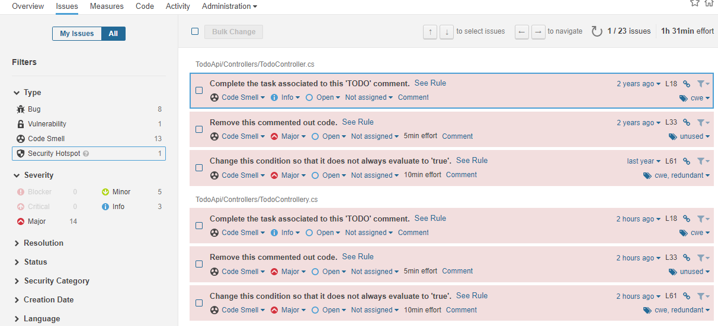
Notes:
This is what the issues list might look like, with lots of information that SonarQube determined based on the code itself and the code’s metadata
We may need to weed through some info here but we can easily find areas where we can focus our testing to get these issues fixed.
Ones we can ignore generally are these style ones – like “remove those useless parentheses”
And look for the more interesting ones like duplicated blocks of code
Expanding any of these bugs in this listing will show us the exact line of code in the file where the bug exists. Another way, and reason, to get more familiar with the code you’re testing

Slide 35
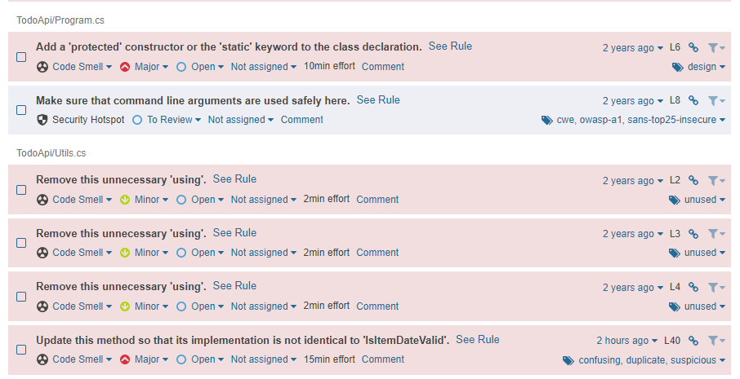
Notes:
Ones we can ignore generally are these style ones – like “remove unnecessary things”
And look for the more interesting ones like this one flagged as a “security hotspot” to make sure things are more safely used
And some duplicated code, though we can see more of that by clicking through on the duplications from the dashboard
Expanding any of these bugs in this listing…

Slide 36
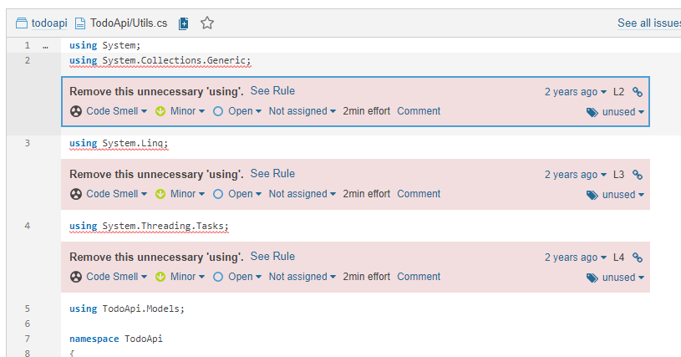
Notes:
will show us the exact line of code in the file where the bug exists. Another way, and reason, to get more familiar with the code you’re testing!

Slide 37
Why care about static analysis?
Learn about the “health” of the codebase
Visibility into bugs we may not see otherwise
Learn about security vulnerabilities
Notes:
So why even care about any of this? Shouldn’t the devs care more about this than us? Probably, but anyway
We can learn a lot about the “health” of the codebase. How our devs treat their own code. If we have automation code, we can do the same for that, too
It gives us visibility into issues we may not see otherwise. It gives us warnings for potential issues and we’d be silly to ignore them
With code smells like duplication, we can see potential issues before they happen. We can see for instance, that a certain function is duplicated, but when someone does a code fix, are they fixing both things? Are they refactoring so it’s not duplicated?
We also learn about security vulnerabilities with the code – if you don’t have security testing experience, this can help you out. This isn’t going to show all of your vulnerabilities but it will identify what’s obviously wrong in the code

Slide 38
Code Coverage
Measure of how much of the code is executed when unit tests are run
Or
How much of the code is NOT unit tested
Not
How high quality the code is
Notes:
We can define code coverage by saying
it’s the measure of how much of the code is executed when unit tests are run
Or what I think is really why we care about code coverage
It’s how much of the code is NOT unit tested. So essentially how much of the code has not been checked prior to it getting to the testers
But we must be careful with code coverage because it is NOT
How high quality the code actually is.

Slide 39
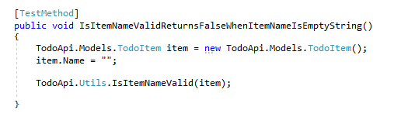
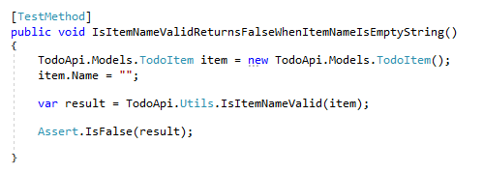
5.05%
Coverage
5.05%
Coverage
Notes:
Let’s look at some actual unit tests so you can see what I mean
This test creates a new item to use within the test, then calls this method “is item name valid”, passing in the new item.
And this is another test that does the same exact thing except it’s
actually checking the results that come back. That first one ISN’T ACTUALLY TESTING ANYTHING.
What’s worse,
they both pass. You see, in a lot of unit test frameworks if you have NO assertion at all, it will pass. Unless of course you run across an exception.
And they both will bring our code coverage up the exact same amount – so whether it’s actually testing anything or not, we get passing tests and code coverage increases

Slide 40
5.05%
Coverage
¯\_(ツ)_/¯
Quality
Notes:
If all we have is this one with no assertion, our code coverage is higher but we have no idea about our code quality because it’s not actually being checked properly with the unit tests!

Slide 41
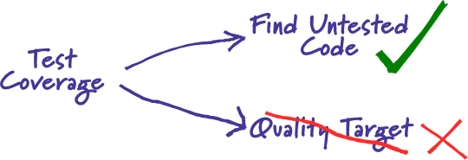
“Test coverage is a useful tool for finding untested parts of a codebase.
Test coverage is of little use as a numeric statement of how good your tests are.”
https://martinfowler.com/bliki/TestCoverage.html
Notes:
I think this statement and diagram from Martin Fowler describe code (or test) coverage the best.

Slide 42
Why care if it’s such a gamble?
Learn about dev behaviors
Learn what’s expected
Learn what’s in danger
Understand the state of the code when you get it
Notes:
So why should you care about code coverage at all if it’s so unpredictable if it’s actually helpful or not?
First of all, you need to know how your developers treat the code they write. Do they even write unit tests? Do they write those “pretend” unit tests that don’t actually test anything?
Learn about what’s expected – not just from the developers (do they have code coverage targets they’re supposed to meet?) but also what’s expected from the code itself.
And learn what’s in danger. If there’s some code that doesn’t have any unit tests, that is a danger zone. If the code itself changes somehow, how will the devs know they didn’t break something? If you know that a certain function isn’t covered at all, and there are some changes, you know that you’ll need to pay extra attention to it
Essentially you should care because you’ll better understand the state the code is in when it’s your turn to test it.

Slide 43
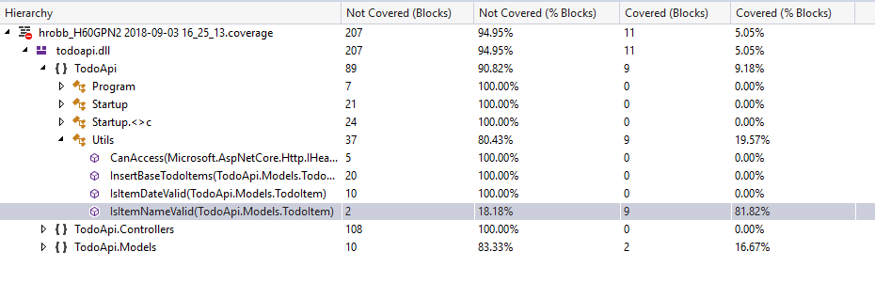
Notes:
There are a couple of ways to see the code coverage, and dig into the code a bit more.
Many development tools have a code coverage extension built-in or downloadable that you can use. For example this is one in Visual Studio.
We can see the percentage covered, what’s not covered, and
we can dig in to the methods themselves. We looked at the unit test for this method earlier – IsItemNameValid. If we go to that method

Slide 44
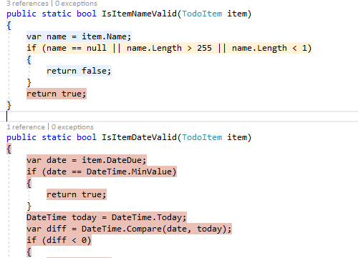
Notes:
We can see what is covered and what isn’t by unit tests, or how Visual Studio calls it “touched” rather than “covered”. The red indicates that this isn’t covered, meaning we don’t have a test that checks for that scenario, yellow means partially covered since our one test covers one of those three scenarios, and blue is covered or “touched”. These colors have varying degrees of visibility depending on your theme and of course if you have any kind of color blindness, and there aren’t any hover-overs to indicate which is which if you can’t tell the colors (the colors are customizable)

Slide 45
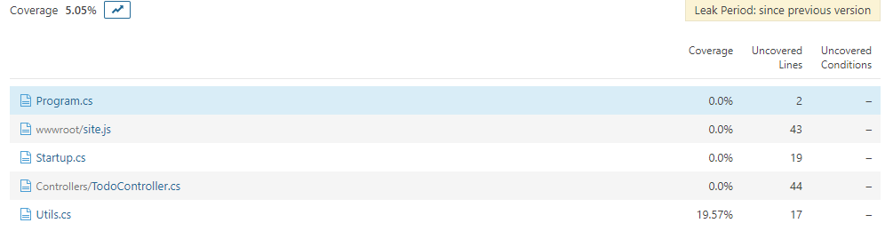
Notes:
We looked at SonarQube a bit before for Static analysis. It also has some neat code coverage tools.\
I don’t have to have the code on my machine to see the code, or the code coverage. That’s pretty cool. Here I can see for this solution, I have these files and just this one has some coverage. I can go into that file

Slide 46
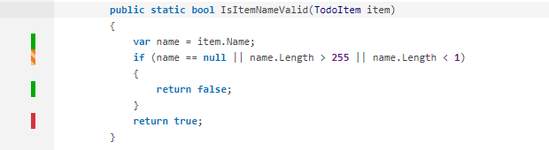
Notes:
And we can see the code coverage indicators are similar to what we saw in Visual Studio – red is something that has no unit tests at all, yellow/orange stripe means it has some coverage. And these have some hovertext in case you can’t distinguish the colors.
So this is a way I can see all of this, without having to have all the tools installed, or lots of training

Slide 47


Empty String
Null
> 255 chars
> 1 and < 255
Numeric
Characters w/ diacritical marks
☃
“Special” characters
Notes:
So looking at this method again, what unit tests need to exist for this to be 100% covered?
We have one test for the empty string, we need to cover null, greater than 255 characters, and then the happy path – between 1 and 255 characters.
But what’s missing here?
For one, we’re not checking any of these “negative” scenarios – numbers, special characters, my favorite Unicode snowman
What if our requirements had further specification for what constitutes a valid name and that’s not even here? For obvious things we might find them while testing, but looking at code coverage gets us looking at the code itself, and how our devs are testing their own work.
When you’re reviewing PRs, look at the tests as well!

Slide 48
How to see static analysis and code coverage?
Find out what tools are in use & learn them
If no tools, advocate for them!
Go rogue!
Notes:
How do you see this amazingly helpful information, then?
Find out what tools your devs are using, and learn them
If there aren’t any tools, advocate for getting them. This raises code quality just by virtue of having visibility into areas that have code smells or completely untested
If you get pushback, or you’re not sure it’ll work with your leadership, go rogue! I set up sonarqube myself on my local machine, and learned how to use the tools in Visual Studio.
Google for a tool that’ll work with the stack you’re working with, and just dive into it!

Slide 49
Dev Tools

Slide 50
Dev tools
Suite of tools in modern browsers to assist with web development and testing
HTML, CSS, JavaScript
Network traffic
Performance
Cookies
Cache
Notes:
Dev tools are amazing tools in browsers that can really help with your testing

Slide 51
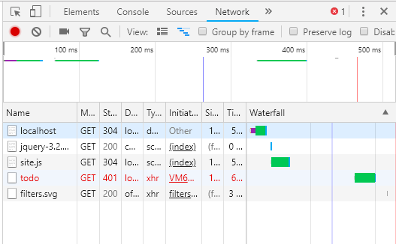
Notes:
Remember that issue we had to troubleshoot earlier, where the header had a misspelling? One way we figured it out was with dev tools!
Remember we could see that we had a 401 error – the text is in red to help us spot errors

Slide 52
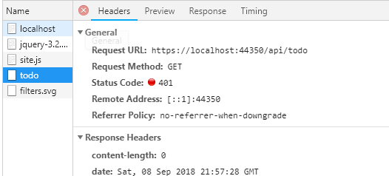
Notes:
And with dev tools we can see the actual request that was made and see the status code – 401 which is unauthorized

Slide 53
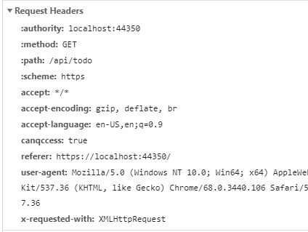
Notes:
And we can dig further to see the request headers, and we can look through each one
* Til we spot our new header that is all wrong
Now that was an obvious issue – we could see the problem plainly because our Todo List wouldn’t load. But should you use dev tools even if you don’t see a problem?

Slide 54
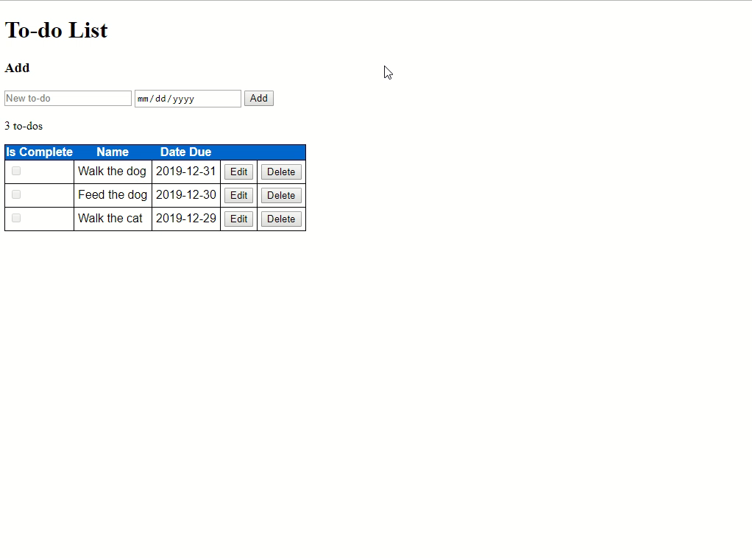
Notes:
YES! The best part about dev tools is it can help you find issues you had no idea about!
This looks like it’s behaving properly, right? My todo item is being added properly

Slide 55
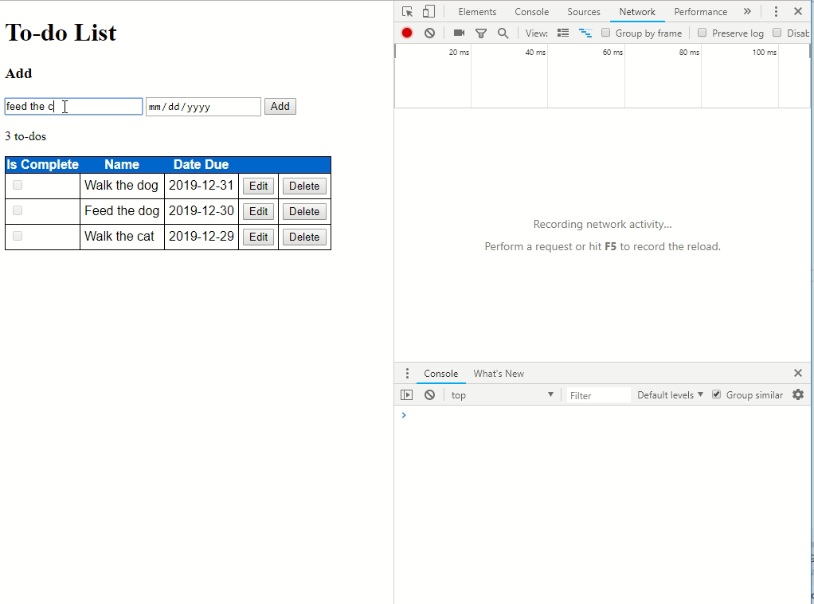
Notes:
But some javascript errors aren’t seen at all by an end user, like this one. Unless you have dev tools up, you have no idea there’s a problem
It’s not just javascript errors. Sometimes your application is calling back to an API, and that API is returning errors that sometimes aren’t surfaced in the UI.
I once caught a 500 error from an external service we were hitting by using the dev tools – it wasn’t visible in the UI at all. My devs were all “oh my gosh, how did you find that” and I just showed them dev tools!

Slide 56
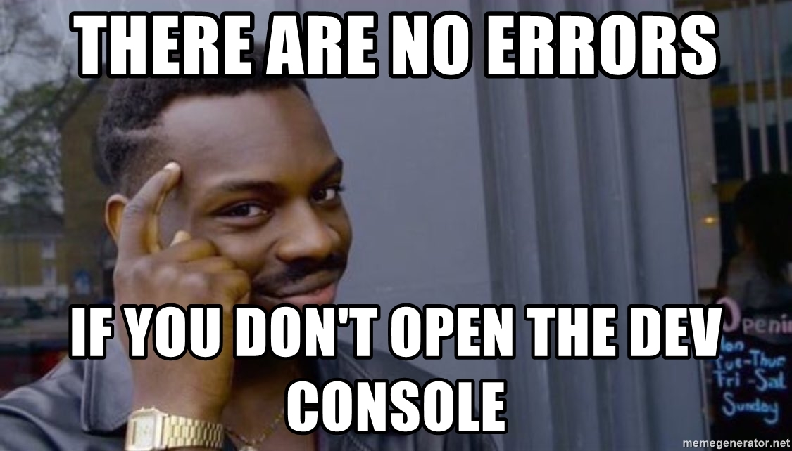
Notes:
But remember, look for how those errors are HANDLED. If you get a 404 error showing in the dev tools, but a popup says “we couldn’t find your item” – then that’s being handled much better than a silent 404. That might not be a bug! It’s all about context!

Slide 57
No browser? No problem!
Fiddler
Charles Proxy
Wireshark
Notes:
If your app isn’t in a browser, you can still use similar tools to help you test! Desktop and mobile apps still talk over the network, and these are some of the tools available to help you see that network traffic.

Slide 58
Why use dev tools?
Peek under the surface
Wealth of information where you’re already testing!
Better understanding of the application
Notes:
Why use those dev tools, and other proxy tools?
These tools give you a view under the surface of the application. You’re able to see what is actually going on, without having to guess!
There’s so much information there that you can use to inform your testing and help you find invisible bugs
And you get a better understanding of the application because you’re able to see those inner workings

Slide 59
Other tools

Slide 60
Other tools to dig in
Logs
Monitoring tools
Support tickets
Other people!
Notes:
Some other tools you can use to dig in and potentially find some new bugs
Logs – these are a treasure trove of information!
Monitoring tools – if you watch an application long enough, it does some wacky shit and you can put a bug in!
Support tickets – if you’re not already looking at what your users are finding, or what support is telling users to do for workarounds, you need to. People generally don’t call support until something is really ticking them off, though. There could be some more minor things that aren’t surfacing. Especially if your users need to pay for support
And other people! Not necessarily people you consider to be “tools” heh Anyone else that uses your software. Sitting with your users, or just talking to other people on the team. Finding their own workarounds for things, or things they’ve noticed but they thought was “just them”. Don’t just always have formal conversations, though. Talk about other stuff and see what comes up naturally – what’s really aggravating them today?

Slide 61
So dig in!

Slide 62
Dig it!
Learn more about the code
Spot issues earlier in the dev cycle
Pinpoint vulnerable areas
Collect & use a ton of information
Notes:
Hopefully you can take back to work on Monday
Ways to learn more about the code, with Commits, PRs, static analysis. Maybe make some changes yourself!
You can spot issues earlier in the cycle by reviewing those PRs, or logging the bugs found by static analysis
You can pinpoint the vulnerable areas in the code by understanding what’s at risk due to lack of unit tests, or duplication of code
And you can collect and use a ton of new information, from static analysis and dev tools

Slide 63

Questions?

